Slide 1
Data Encryption Standard3
Notes:
William Stallings, Chapter 3 – “Block Ciphers and the Data Encryption Standard”.

Slide 2
Modern Block Ciphers
now look at modern block ciphers
one of the most widely used types of cryptographic algorithms
provide secrecy /authentication services
focus on DES (Data Encryption Standard)
to illustrate block cipher design principles
Notes:
Modern block ciphers are widely used to provide encryption of quantities of information, and/or a cryptographic checksum to ensure the contents have not been altered. We continue to use block ciphers because they are comparatively fast, and because we know a fair amount about how to design them. Will use the widely known DES algorithm to illustrate some key block cipher design principles.

Slide 3
Block vs Stream Ciphers
block ciphers process messages in blocks, each of which is then en/decrypted
like a substitution on very big characters
  64-bits or more
stream ciphers process messages a bit or byte at a time when en/decrypting
many current ciphers are block ciphers
broader range of applications
Notes:
Block ciphers work a on block / word at a time, which is some number of bits. All of these bits have to be available before the block can be processed. Stream ciphers work on a bit or byte of the message at a time, hence process it as a “stream”. Block ciphers are currently better analysed, and seem to have a broader range of applications, hence focus on them.

Slide 4
Block Cipher Principles
most symmetric block ciphers are based on a Feistel Cipher Structure
needed since must be able to decrypt ciphertext to recover messages efficiently
block ciphers look like an extremely large substitution
would need table of 2⁶⁴ entries for a 64-bit block
instead create from smaller building blocks
using idea of a product cipher
Notes:
Most symmetric block encryption algorithms in current use are based on a structure referred to as a Feistel block cipher. A block cipher operates on a plaintext block of n bits to produce a ciphertext block of n bits. An arbitrary reversible substitution cipher for a large block size is not practical, however, from an implementation and performance point of view. In general, for an n-bit general substitution block cipher, the size of the key is n x 2^{n}. For a 64-bit block, which is a desirable length to thwart statistical attacks, the key size is 64 x 2⁶⁴ = 2⁷⁰ = 10²¹ bits. In considering these difficulties, Feistel points out that what is needed is an approximation to the ideal block cipher system for large n, built up out of components that are easily realizable.

Slide 5

Ideal Block Cipher
Notes:
Feistel refers to an n-bit general substitution as an ideal block cipher, because it allows for the maximum number of possible encryption mappings from the plaintext to ciphertext block. A 4-bit input produces one of 16 possible input states, which is mapped by the substitution cipher into a unique one of 16 possible output states, each of which is represented by 4 ciphertext bits. The encryption and decryption mappings can be defined by a tabulation, as shown in Stallings Figure 3.1. It illustrates a tiny 4-bit substitution to show that each possible input can be arbitrarily mapped to any output - which is why its complexity grows so rapidly.

Slide 6
Claude Shannon and Substitution-Permutation Ciphers
Claude Shannon introduced idea of substitution-permutation (S-P) networks in 1949 paper
form basis of modern block ciphers
S-P nets are based on the two primitive cryptographic operations seen before:
  substitution (S-box)
  permutation (P-box)
provide confusion & diffusion of message & key
Notes:
Claude Shannon’s 1949 paper has the key ideas that led to the development of modern block ciphers. Critically, it was the technique of layering groups of S-boxes separated by a larger P-box to form the S-P network, a complex form of a product cipher. He also introduced the ideas of confusion and diffusion, notionally provided by S-boxes and P-boxes (in conjunction with S-boxes).

Slide 7
Confusion and Diffusion
cipher needs to completely obscure statistical properties of original message
a one-time pad does this
more practically Shannon suggested combining S & P elements to obtain:
diffusion – dissipates statistical structure of plaintext over bulk of ciphertext
confusion – makes relationship between ciphertext and key as complex as possible
Notes:
The terms diffusion and confusion were introduced by Claude Shannon to capture the two basic building blocks for any cryptographic system. Every block cipher involves a transformation of a block of plaintext into a block of ciphertext, where the transformation depends on the key. The mechanism of diffusion seeks to make the statistical relationship between the plaintext and ciphertext as complex as possible in order to thwart attempts to deduce the key. Confusion seeks to make the relationship between the statistics of the ciphertext and the value of the encryption key as complex as possible, again to thwart attempts to discover the key.
So successful are diffusion and confusion in capturing the essence of the desired attributes of a block cipher that they have become the cornerstone of modern block cipher design.

Slide 8
Feistel Cipher Structure
Horst Feistel devised the feistel cipher
  based on concept of invertible product cipher
partitions input block into two halves
  process through multiple rounds which
  perform a substitution on left data half
  based on round function of right half & subkey
  then have permutation swapping halves
implements Shannon’s S-P net concept
Notes:
Horst Feistel, working at IBM Thomas J Watson Research Labs devised a suitable invertible cipher structure in early 70's.
One of Feistel's main contributions was the invention of a suitable structure which adapted Shannon's S-P network in an easily inverted structure. It partitions input block into two halves which are processed through multiple rounds which perform a substitution on left data half, based on round function of right half & subkey, and then have permutation swapping halves. Essentially the same h/w or s/w is used for both encryption and decryption, with just a slight change in how the keys are used. One layer of S-boxes and the following P-box are used to form the round function.

Slide 9
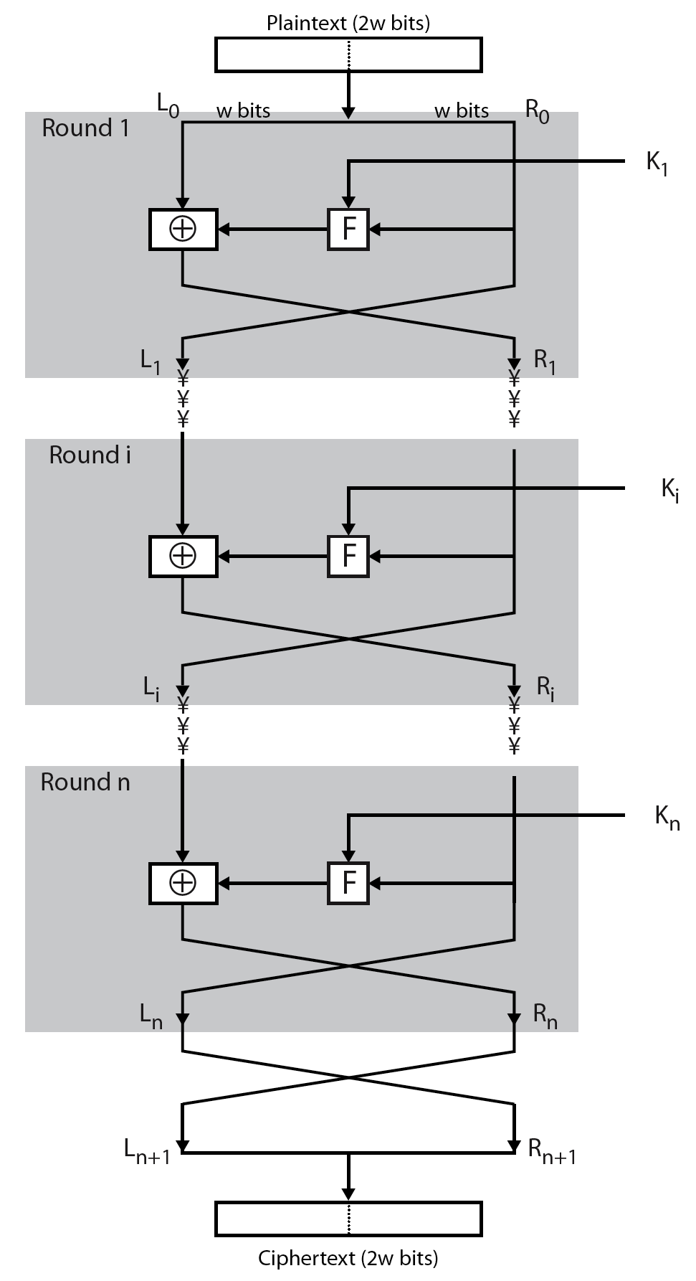
Feistel Cipher Structure
Notes:
Stallings Figure 3.2 illustrates the classical feistel cipher structure, with data split in 2 halves, processed through a number of rounds which perform a substitution on left half using output of round function on right half & key, and a permutation which swaps halves, as listed previously.

Slide 10
Feistel Cipher Design Elements
block size
key size
number of rounds
subkey generation algorithm
round function
fast software en/decryption
ease of analysis
Notes:
The exact realization of a Feistel network depends on the choice of the following parameters and design features:
block size - increasing size improves security, but slows cipher
key size - increasing size improves security, makes exhaustive key searching harder, but may slow cipher
number of rounds - increasing number improves security, but slows cipher
subkey generation algorithm - greater complexity can make analysis harder, but slows cipher
round function - greater complexity can make analysis harder, but slows cipher
fast software en/decryption - more recent concern for practical use
ease of analysis - for easier validation & testing of strength

Slide 11
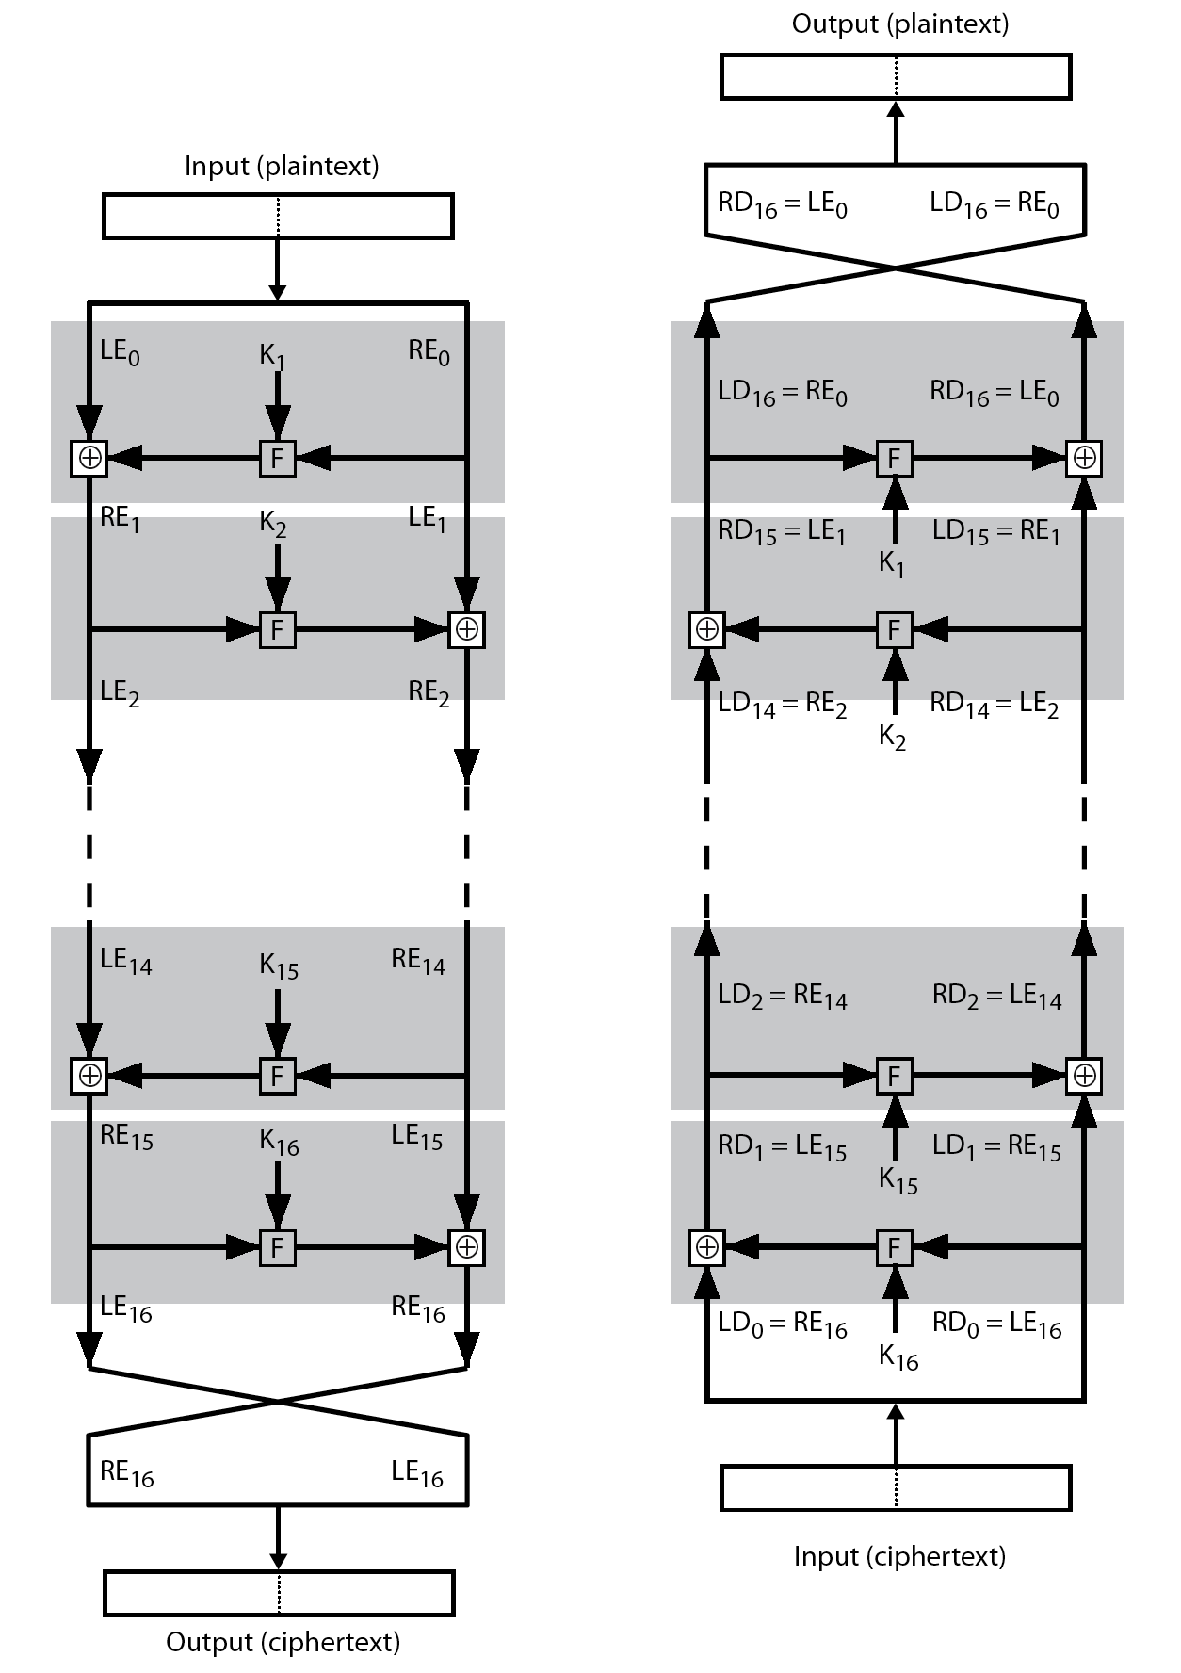
Feistel Cipher Decryption
Notes:
The process of decryption with a Feistel cipher, as shown in Stallings Figure 3.3, is essentially the same as the encryption process. The rule is as follows: Use the ciphertext as input to the algorithm, but use the subkeys Ki in reverse order. That is, use Kn in the first round, Kn–1 in the second round, and so on until K1 is used in the last round. This is a nice feature because it means we need not implement two different algorithms, one for encryption and one for decryption.

Slide 12
Data Encryption Standard (DES)
most widely used block cipher in world
adopted in 1977 by NBS (now NIST)
  as FIPS PUB 46
encrypts 64-bit data using 56-bit key
has widespread use
has been considerable controversy over its security
Notes:
The most widely used private key block cipher, is the Data Encryption Standard (DES). It was adopted in 1977 by the National Bureau of Standards as Federal Information Processing Standard 46 (FIPS PUB 46). DES encrypts data in 64-bit blocks using a 56-bit key. The DES enjoys widespread use. It has also been the subject of much controversy its security.

Slide 13
DES History
IBM developed Lucifer cipher
  by team led by Feistel in late 60’s
  used 64-bit data blocks with 128-bit key
then redeveloped as a commercial cipher with input from NSA and others
in 1973 NBS issued request for proposals for a national cipher standard
IBM submitted their revised Lucifer which was eventually accepted as the DES
Notes:
In the late 1960s, IBM set up a research project in computer cryptography led by Horst Feistel. The project concluded in 1971 with the development of the LUCIFER algorithm. LUCIFER is a Feistel block cipher that operates on blocks of 64 bits, using a key size of 128 bits.
Because of the promising results produced by the LUCIFER project, IBM embarked on an effort, headed by Walter Tuchman and Carl Meyer, to develop a marketable commercial encryption product that ideally could be implemented on a single chip. It involved not only IBM researchers but also outside consultants and technical advice from NSA. The outcome of this effort was a refined version of LUCIFER that was more resistant to cryptanalysis but that had a reduced key size of 56 bits, to fit on a single chip.
In 1973, the National Bureau of Standards (NBS) issued a request for proposals for a national cipher standard. IBM submitted the modified LUCIFER. It was by far the best algorithm proposed and was adopted in 1977 as the Data Encryption Standard.

Slide 14
DES Design Controversy
although DES standard is public
was considerable controversy over design
  in choice of 56-bit key (vs Lucifer 128-bit)
  and because design criteria were classified
subsequent events and public analysis show in fact design was appropriate
use of DES has flourished
  especially in financial applications
  still standardised for legacy application use
Notes:
Before its adoption as a standard, the proposed DES was subjected to intense & continuing criticism over the size of its key & the classified design criteria.
Recent analysis has shown despite this controversy, that DES is well designed. DES is theoretically broken using Differential or Linear Cryptanalysis but in practise is unlikely to be a problem yet. Also rapid advances in computing speed though have rendered the 56 bit key susceptible to exhaustive key search, as predicted by Diffie & Hellman.
DES has flourished and is widely used, especially in financial applications. It is still standardized for legacy systems, with either AES or triple DES for new applications.

Slide 15
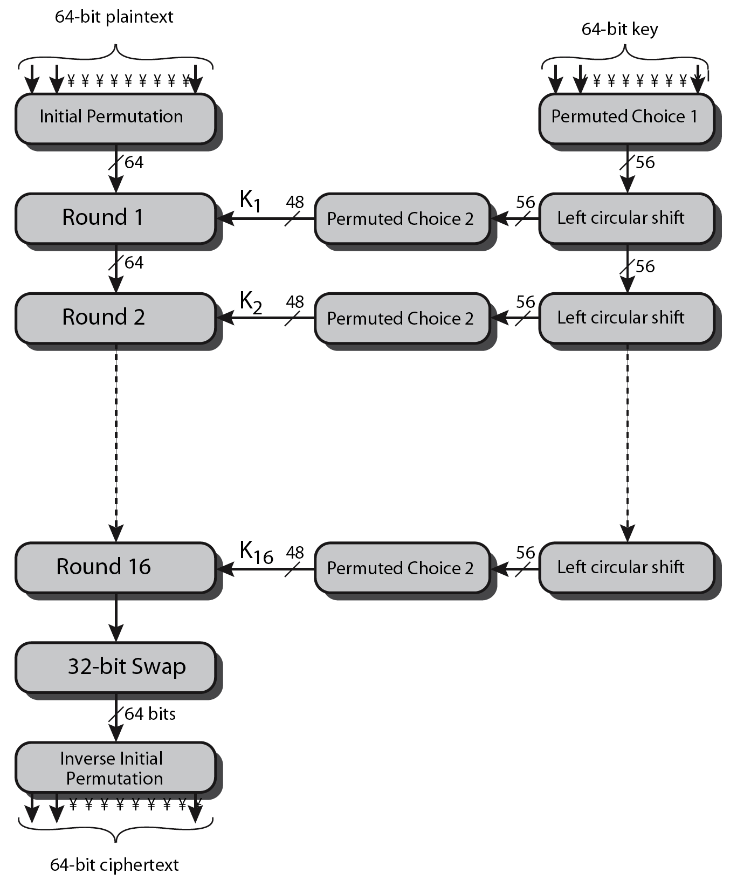
DES Encryption Overview
Notes:
The overall scheme for DES encryption is illustrated in Stallings Figure3.4, which takes as input 64-bits of data and of key.
The left side shows the basic process for enciphering a 64-bit data block which consists of:
- an initial permutation (IP) which shuffles the 64-bit input block
- 16 rounds of a complex key dependent round function involving substitutions & permutations
- a final permutation, being the inverse of IP
The right side shows the handling of the 56-bit key and consists of:
- an initial permutation of the key (PC1) which selects 56-bits out of the 64-bits input, in two 28-bit halves
- 16 stages to generate the 48-bit subkeys using a left circular shift and a permutation of the two 28-bit halves

Slide 16
DES Round Structure
uses two 32-bit L & R halves
as for any Feistel cipher can describe as:
  L_{i} = R_{i–1}
  R_{i} = L_{i–1} ⊕ F(R_{i–1}, K_{i})
F takes 32-bit R half and 48-bit subkey:
  expands R to 48-bits using perm E
  adds to subkey using XOR
  passes through 8 S-boxes to get 32-bit result
  finally permutes using 32-bit perm P
Notes:
Detail here the internal structure of the DES round function F, which takes R half & subkey, and processes them through E, add subkey, S & P.
This follows the classic structure for a feistel cipher.
Note that the s-boxes provide the “confusion” of data and key values, whilst the permutation P then spreads this as widely as possible, so each S-box output affects as many S-box inputs in the next round as possible, giving “diffusion”.

Slide 17
DES Key Schedule
forms subkeys used in each round
  initial permutation of the key (PC1) which selects 56-bits in two 28-bit halves
  16 stages consisting of:
    rotating each half separately either 1 or 2 places depending on the key rotation schedule K
    selecting 24-bits from each half & permuting them by PC2 for use in round function F
note practical use issues in h/w vs s/w
Notes:
The DES Key Schedule generates the subkeys needed for each data encryption round. The 64-bit key input is first processed by Permuted Choice One (Stallings Table 3.4b). The resulting 56-bit key is then treated as two 28-bit quantities C & D. In each round, these are separately processed throgh a circular left shift (rotation) of 1 or 2bits as shown in Stallings Table 3.4d. These shifted values serve as input to the next round of the key schedule. They also serve as input to Permuted Choice Two (Stallings Table 3.4c), which produces a 48-bit output that serves as input to the round function F.
The 56 bit key size comes from security considerations as we know now. It was big enough so that an exhaustive key search was about as hard as the best direct attack (a form of differential cryptanalysis called a T-attack, known by the IBM & NSA researchers), but no bigger. The extra 8 bits were then used as parity (error detecting) bits, which makes sense given the original design use for hardware communications links. However we hit an incompatibility with simple s/w implementations since the top bit in each byte is 0 (since ASCII only uses 7 bits), but the DES key schedule throws away the bottom bit! A good implementation needs to be cleverer!

Slide 18
DES Decryption
decrypt must unwind steps of data computation
with Feistel design, do encryption steps again using subkeys in reverse order (SK16 … SK1)
  IP undoes final FP step of encryption
  1st round with SK16 undoes 16th encrypt round
  ….
  16th round with SK1 undoes 1st encrypt round
  then final FP undoes initial encryption IP
  thus recovering original data value
Notes:
As with any Feistel cipher, DES decryption uses the same algorithm as encryption except that the subkeys are used in reverse order SK16 .. SK1.
If you trace through the DES overview diagram can see how each decryption step top to bottom with reversed subkeys, undoes the equivalent encryption step moving from bottom to top.

Slide 19
Strength of DES – Key Size
56-bit keys have 2⁵⁶ = 7.2 x 10¹⁶ values
brute force search looks hard
recent advances have shown is possible
  in 1997 on Internet in a few months
  in 1998 on dedicated h/w (EFF) in a few days
  in 1999 above combined in 22hrs!
still must be able to recognize plaintext
must now consider alternatives to DES
Notes:
Since its adoption as a federal standard, there have been lingering concerns about the level of security provided by DES in two areas: key size and the nature of the algorithm.
With a key length of 56 bits, there are 2^56 possible keys, which is approximately 7.2*10^16 keys. Thus a brute-force attack appeared impractical.
However DES was finally and definitively proved insecure in July 1998, when the Electronic Frontier Foundation (EFF) announced that it had broken a DES encryption using a special-purpose "DES cracker" machine that was built for less than $250,000. The attack took less than three days. The EFF has published a detailed description of the machine, enabling others to build their own cracker [EFF98].
There have been other demonstrated breaks of the DES using both large networks of computers & dedicated h/w, including:
- 1997 on a large network of computers in a few months
- 1998 on dedicated h/w (EFF) in a few days
- 1999 above combined in 22hrs!
It is important to note that there is more to a key-search attack than simply running through all possible keys. Unless known plaintext is provided, the analyst must be able to recognize plaintext as plaintext.
Clearly must now consider alternatives to DES, the most important of which are AES and triple DES.

Slide 20
Strength of DES – Analytic Attacks
now have several analytic attacks on DES
these utilise some deep structure of the cipher
  by gathering information about encryptions
  can eventually recover some/all of the sub-key bits
  if necessary then exhaustively search for the rest
generally these are statistical attacks
include
  differential cryptanalysis
  linear cryptanalysis
  related key attacks
Notes:
Another concern is the possibility that cryptanalysis is possible by exploiting the characteristics of the DES algorithm. The focus of concern has been on the eight substitution tables, or S-boxes, that are used in each iteration. These techniques utilise some deep structure of the cipher by gathering information about encryptions so that eventually you can recover some/all of the sub-key bits, and then exhaustively search for the rest if necessary. Generally these are statistical attacks which depend on the amount of information gathered for their likelihood of success. Attacks of this form include differential cryptanalysis. linear cryptanalysis, and related key attacks.

Slide 21
Strength of DES – Timing Attacks
attacks actual implementation of cipher
use knowledge of consequences of implementation to derive information about some/all subkey bits
specifically use fact that calculations can take varying times depending on the value of the inputs to it
particularly problematic on smartcards
Notes:
We will discuss timing attacks in more detail later, as they relate to public-key algorithms. However,the issue may also be relevant for symmetric ciphers. A timing attack is one in which information about the key or the plaintext is obtained by observing how long it takes a given implementation to perform decryptions on various ciphertexts. A timing attack exploits the fact that an encryption or decryption algorithm often takes slightly different amounts of time on different inputs. The AES analysis process has highlighted this attack approach, and showed that it is a concern particularly with smartcard implementations, though DES appears to be fairly resistant to a successful timing attack.

Slide 22
Differential Cryptanalysis
one of the most significant recent (public) advances in cryptanalysis
known by NSA in 70's cf DES design
Murphy, Biham & Shamir published in 90’s
powerful method to analyse block ciphers
used to analyse most current block ciphers with varying degrees of success
DES reasonably resistant to it, cf Lucifer
Notes:
Biham & Shamir show Differential Cryptanalysis can be successfully used to cryptanalyse the DES with an effort on the order of 2⁴⁷ encryptions, requiring 2⁴⁷ chosen plaintexts. They also demonstrated this form of attack on a variety of encryption algorithms and hash functions.
Differential cryptanalysis was known to the IBM DES design team as early as 1974 (as a T attack), and influenced the design of the S-boxes and the permutation P to improve its resistance to it. Compare DES’s security with the cryptanalysis of an eight-round LUCIFER algorithm which requires only 256 chosen plaintexts, verses an attack on an eight-round version of DES requires 2¹⁴ chosen plaintexts.

Slide 23
Differential Cryptanalysis
a statistical attack against Feistel ciphers
uses cipher structure not previously used
design of S-P networks has output of function f influenced by both input & key
hence cannot trace values back through cipher without knowing value of the key
differential cryptanalysis compares two related pairs of encryptions
Notes:
The differential cryptanalysis attack is complex. The rationale behind differential cryptanalysis is to observe the behavior of pairs of text blocks evolving along each round of the cipher, instead of observing the evolution of a single text block. Each round of DES maps the right-hand input into the left-hand output and sets the right-hand output to be a function of the left-hand input and the subkey for this round, which means you cannot trace values back through cipher without knowing the value of the key. Differential Cryptanalysis compares two related pairs of encryptions, which can leak information about the key, given a sufficiently large number of suitable pairs.

Slide 24
Differential Cryptanalysis
have some input difference giving some output difference with probability p
if find instances of some higher probability input / output difference pairs occurring
can infer subkey that was used in round
then must iterate process over many rounds (with decreasing probabilities)
Notes:
The overall strategy of differential cryptanalysis is based on these considerations for a single round. The procedure is to begin with two plaintext messages m and m’ with a given difference and trace through a probable pattern of differences after each round to yield a probable difference for the ciphertext. You submit m and m’ for encryption to determine the actual difference under the unknown key and compare the result to the probable difference. If there is a match, then suspect that all the probable patterns at all the intermediate rounds are correct. With that assumption, can make some deductions about the key bits. This procedure must be repeated many times to determine all the key bits.

Slide 25
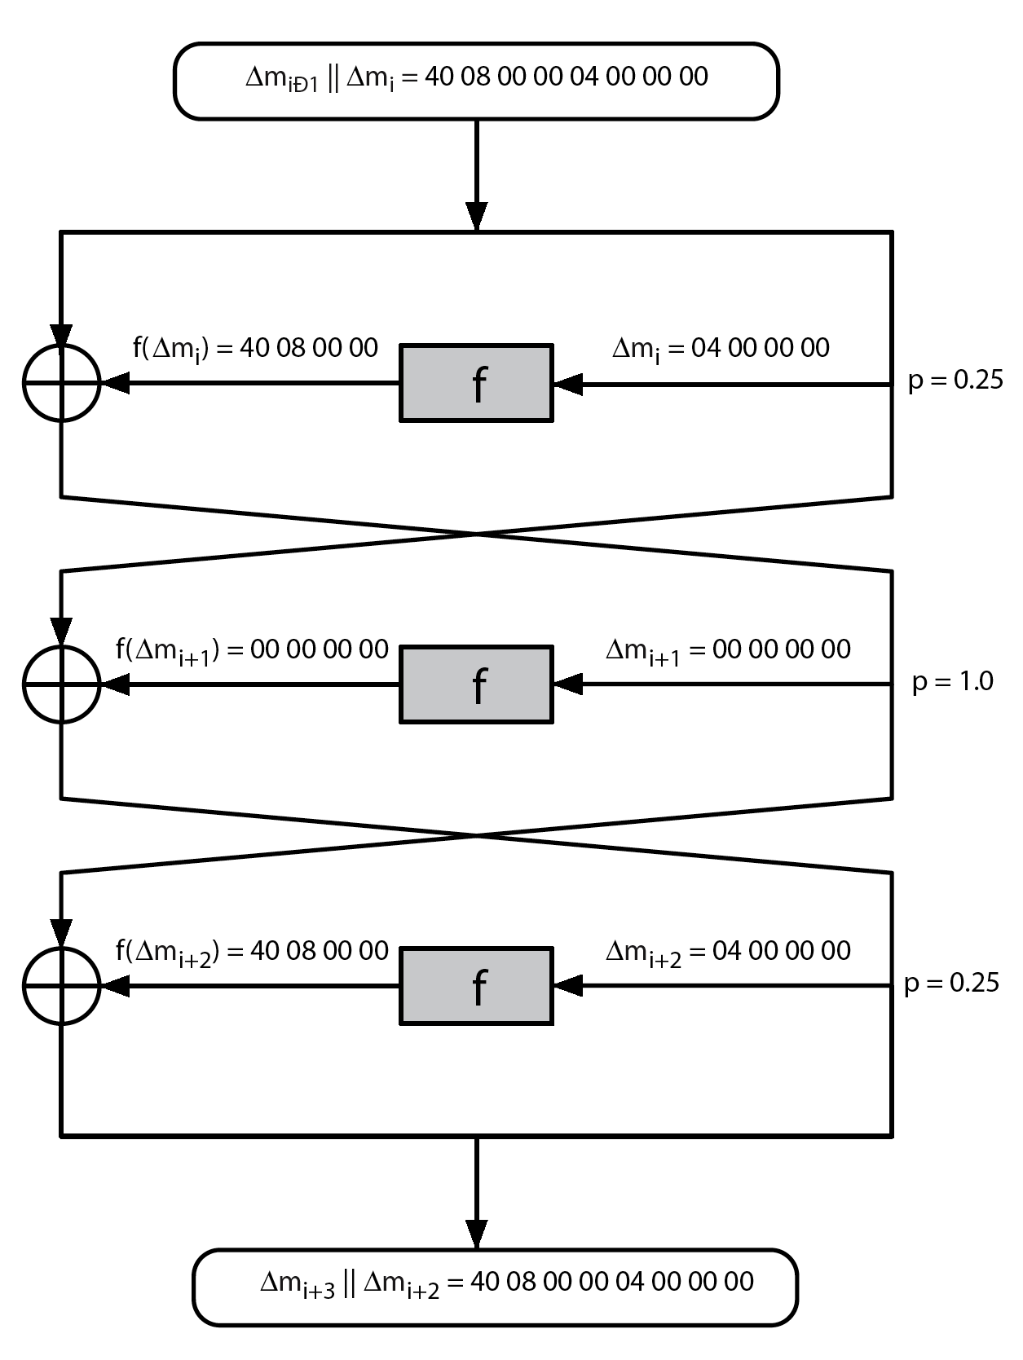
Differential Cryptanalysis
Notes:
Stallings Figure 3.7 illustrates the propagation of differences through three rounds of DES. The probabilities shown on the right refer to the probability that a given set of intermediate differences will appear as a function of the input differences. Overall, after three rounds the probability that the output difference is as shown is equal to 0.25*1*0.25=0.0625. Since the output difference is the same as the input, this 3 round pattern can be iterated over a larger number of rounds, with probabilities
multiplying to be successively smaller.

Slide 26
Differential Cryptanalysis
perform attack by repeatedly encrypting plaintext pairs with known input XOR until obtain desired output XOR
when found
  if intermediate rounds match required XOR have a right pair
  if not then have a wrong pair, relative ratio is S/N for attack
can then deduce keys values for the rounds
  right pairs suggest same key bits
  wrong pairs give random values
for large numbers of rounds, probability is so low that more pairs are required than exist with 64-bit inputs
Biham and Shamir have shown how a 13-round iterated characteristic can break the full 16-round DES
Notes:
Differential Cryptanalysis works by performing the attack by repeatedly encrypting plaintext pairs with known input XOR until obtain desired output XOR. See [BIHA93] for detailed descriptions. Attack on full DES requires an effort on the order of 2⁴⁷ encryptions, requiring 2⁴⁷ chosen plaintexts to be encrypted, with a considerable amount of analysis – in practise exhaustive search is still easier, even though up to 2⁵⁵ encryptions are required for this.

Slide 27
Linear Cryptanalysis
another recent development
also a statistical method
must be iterated over rounds, with decreasing probabilities
developed by Matsui et al in early 90's
based on finding linear approximations
can attack DES with 2⁴³ known plaintexts, easier but still in practise infeasible
Notes:
A more recent development is linear cryptanalysis. This attack is based on finding linear approximations to describe the transformations performed in DES. This method can find a DES key given 2^43 known plaintexts, as compared to 2^47 chosen plaintexts for differential cryptanalysis. Although this is a minor improvement, because it may be easier to acquire known plaintext rather than chosen plaintext, it still leaves linear cryptanalysis infeasible as an attack on DES. Again, this attack uses structure not seen before. So far, little work has been done by other groups to validate the linear cryptanalytic approach.

Slide 28
Linear Cryptanalysis
find linear approximations with prob p != ½
  P[i₁,i₂,...,i_{a}] ⊕ C[j₁,j₂,...,j_{b}] = K[k₁,k₂,...,k_{c}]
  where i_{a},j_{b},k_{c} are bit locations in P,C,K
gives linear equation for key bits
get one key bit using max likelihood alg
using a large number of trial encryptions
effectiveness given by: |p–¹/₂|
Notes:
The objective of linear cryptanalysis is to find an effective linear equation relating some plaintext, ciphertext and key bits that holds with probability p<>0.5 as shown. Once a proposed relation is determined, the procedure is to compute the results of the left-hand side of the equation for a large number of plaintext-ciphertext pairs, in order to determine whether the sum of the key bits is 0 or 1, thus giving 1 bit of info about them. This is repeated for other equations and many pairs to derive some of the key bit values. Because we are dealing with linear equations, the problem can be approached one round of the cipher at a time, with the results combined. See [MATS93] for details.

Slide 29
DES Design Criteria
as reported by Coppersmith in [COPP94]
7 criteria for S-boxes provide for
  non-linearity
  resistance to differential cryptanalysis
  good confusion
3 criteria for permutation P provide for
  increased diffusion
Notes:
Although much progress has been made in designing block ciphers that are cryptographically strong, the basic principles have not changed all that much since the work of Feistel and the DES design team in the early 1970s. Some of the criteria used in the design of DES were reported in [COPP94], and focused on the design of the S-boxes and on the P function that distributes the output of the S boxes, as summarized above. See text for further details.

Slide 30
Summary
have considered:
  block vs stream ciphers
  Feistel cipher design & structure
  DES
    details
    strength
  Differential & Linear Cryptanalysis
  block cipher design principles
Notes:
Chapter 3 summary.

Slide 31
Advance Encryption Standard

Slide 32
Topics
Origin of AES
Basic AES
Inside Algorithm

Slide 33
Origins
A replacement for DES was needed
  Key size is too small
Can use Triple-DES – but slow, small block
US NIST issued call for ciphers in 1997
15 candidates accepted in Jun 98
5 were shortlisted in Aug 99
Notes:
The Advanced Encryption Standard (AES) was published by NIST (National Institute of Standards and Technology) in 2001. AES is a symmetric block cipher that is intended to replace DES as the approved standard for a wide range of applications. The AES cipher (& other candidates) form the latest generation of block ciphers, and now we see a significant increase in the block size - from the old standard of 64-bits up to 128-bits; and keys from 128 to 256-bits. In part this has been driven by the public demonstrations of exhaustive key searches of DES. Whilst triple-DES is regarded as secure and well understood, it is slow, especially in s/w. In a first round of evaluation, 15 proposed algorithms were accepted. A second round narrowed the field to 5 algorithms. NIST completed its evaluation process and published a final standard (FIPS PUB 197) in November of 2001. NIST selected Rijndael as the proposed AES algorithm. The two researchers who developed and submitted Rijndael for the AES are both cryptographers from Belgium: Dr. Joan Daemen and Dr.Vincent Rijmen.

Slide 34
AES Security
AES was designed after DES.
Most of the known attacks on DES were already tested on AES.
Brute-Force Attack
  AES is definitely more secure than DES due to the larger-size key.
Statistical Attacks
  Numerous tests have failed to do statistical analysis of the ciphertext
Differential and Linear Attacks
  There are no differential and linear attacks on AES as yet.

Slide 35
AES Competition Requirements
Private key symmetric block cipher
128-bit data, 128/192/256-bit keys
Stronger & faster than Triple-DES
Provide full specification & design details
Both C & Java implementations
Notes:
Listed above are NIST’s requirements for the AES candidate submissions. These criteria span the range of concerns for the practical application of modern symmetric block ciphers.

Slide 36
AES Evaluation Criteria
initial criteria:
  security – effort for practical cryptanalysis
  cost – in terms of computational efficiency
  algorithm & implementation characteristics
final criteria
  general security
  ease of software & hardware implementation
  implementation attacks
  flexibility (in en/decrypt, keying, other factors)
Notes:
In fact, two set of criteria evolved. When NIST issued its original request for candidate algorithm nominations in 1997, the request stated that candidate algorithms would be compared based on the factors shown in Stallings Table5.1, which were used to evaluate field of 15 candidates to select shortlist of 5. These had categories of security, cost, and algorithm & implementation characteristics.
The final criteria evolved during the evaluation process, and were used to select Rijndael from that short-list, and more details are given in Stallings Table 5.2, with categories of: general security, ease of software & hardware implementation, implementation attacks, & flexibility (in en/decrypt, keying, other factors).

Slide 37
AES Shortlist
After testing and evaluation, shortlist in Aug-99
  MARS (IBM) - complex, fast, high security margin
  RC6 (USA) - v. simple, v. fast, low security margin
  Rijndael (Belgium) - clean, fast, good security margin
  Serpent (Euro) - slow, clean, v. high security margin
  Twofish (USA) - complex, v. fast, high security margin
Found contrast between algorithms with
  few complex rounds versus many simple rounds
  Refined versions of existing ciphers versus new proposals
Rijndae: pronounce “Rain-Dahl”
Notes:
The AES shortlist of 5 ciphers was as shown. Note mix of commercial (MARS, RC6, Twofish) verses academic (Rijndael, Serpent) proposals, sourced from various countries.
All were thought to be good – it came down to the best balance of attributes to meet criteria, in particular the balance between speed, security & flexibility.

Slide 38
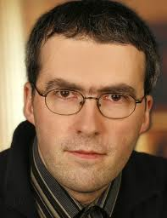

The AES Cipher - Rijndael
Rijndael was selected as the AES in Oct-2000
  Designed by Vincent Rijmen and Joan Daemen in Belgium
  Issued as FIPS PUB 197 standard in Nov-2001
An iterative rather than Feistel cipher
  processes data as block of 4 columns of 4 bytes (128 bits)
  operates on entire data block in every round
Rijndael design:
  simplicity
  has 128/192/256 bit keys, 128 bits data
  resistant against known attacks
  speed and code compactness on many CPUs
V. Rijmen
J. Daemen
Notes:
The Rijndael proposal for AES defined a cipher in which the block length and the key length can be independently specified to be 128,192,or 256 bits. The AES specification uses the same three key size alternatives but limits the block length to 128 bits. Rijndael is an academic submission, based on the earlier Square cipher, from Belgium academics Dr Joan Daemen and Dr Vincent Rijmen. It is an iterative cipher (operates on entire data block in every round) rather than feistel (operate on halves at a time), and was designed to have characteristics of: Resistance against all known attacks, Speed and code compactness on a wide range of platforms, & Design simplicity.

Slide 39
Topics
Origin of AES
Basic AES
Inside Algorithm
Final Notes

Slide 40
AES Conceptual Scheme
Plaintext (128 bits)
AES
Key (128-256 bits)
Ciphertext (128 bits)

Slide 41
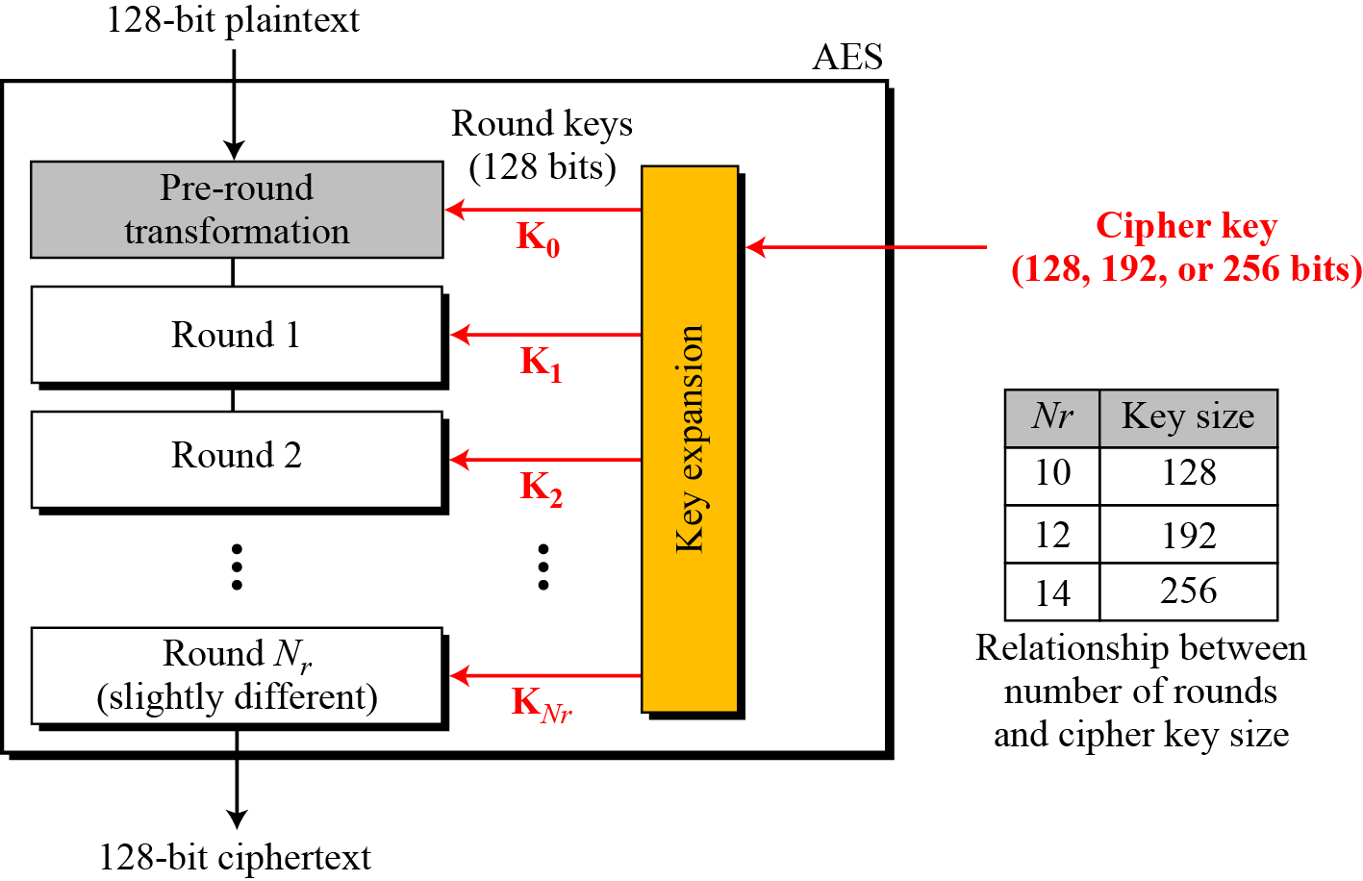
Multiple rounds
Rounds are (almost) identical
  First and last round are a little different
Notes:
The input to the AES encryption and decryption algorithms is a single 128-bit block, depicted in FIPS PUB 197, as a square matrix of bytes .This block is copied into the State array, which is modified at each stage of encryption or decryption. After the final stage, State is copied to an output.
The key is expanded into 44/52/60 lots of 32-bit words (see later), with 4 used in each round.
The data computation then consists of an “add round key” step, then 9/11/13 rounds with all 4 steps, and a final 10th/12th/14th step of byte subs + mix cols + add round key. This can be viewed as alternating XOR key & scramble data bytes operations. All of the steps are easily reversed, and can be efficiently implemented using XOR’s & table lookups.

Slide 42
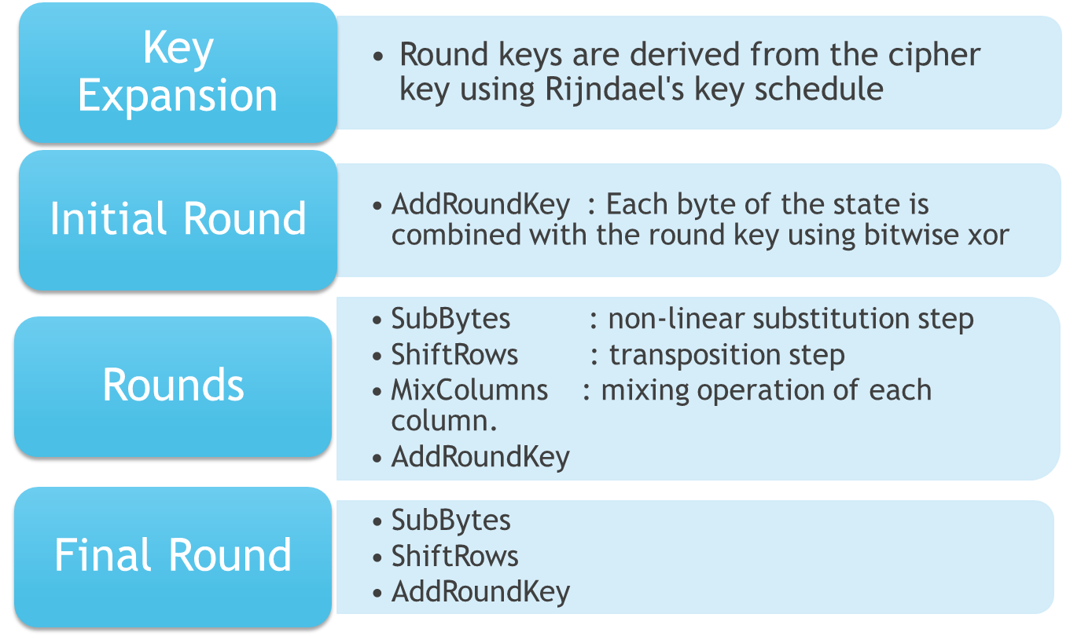
High Level Description
No MixColumns
Notes:
The input to the AES encryption and decryption algorithms is a single 128-bit block, depicted in FIPS PUB 197, as a square matrix of bytes .This block is copied into the State array, which is modified at each stage of encryption or decryption. After the final stage, State is copied to an output.
The key is expanded into 44/52/60 lots of 32-bit words (see later), with 4 used in each round.
The data computation then consists of an “add round key” step, then 9/11/13 rounds with all 4 steps, and a final 10th/12th/14th step of byte subs + mix cols + add round key. This can be viewed as alternating XOR key & scramble data bytes operations. All of the steps are easily reversed, and can be efficiently implemented using XOR’s & table lookups.

Slide 43
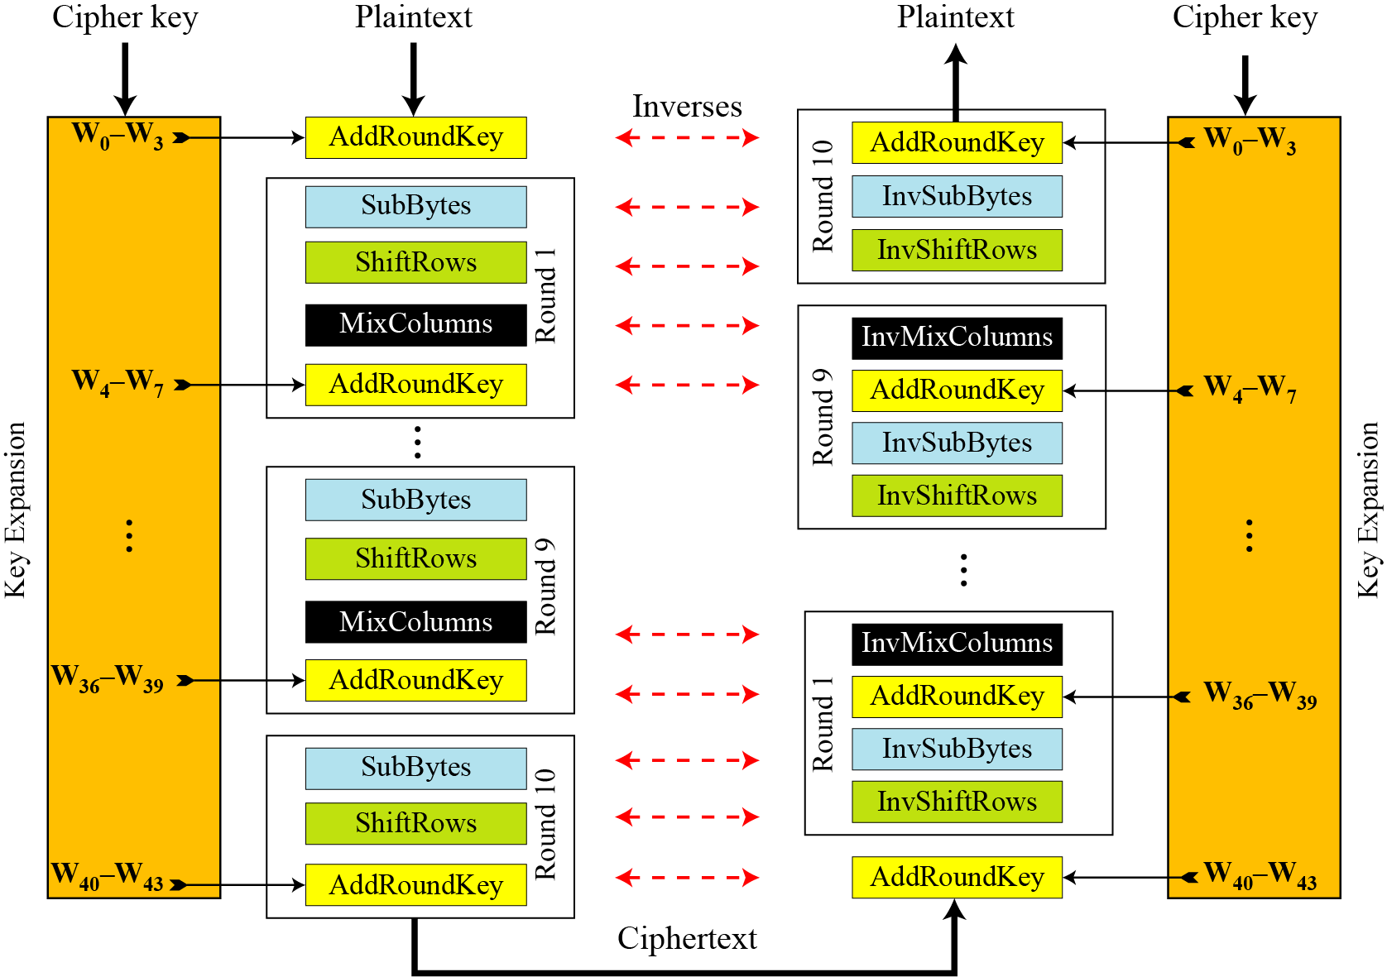
Overall Structure
Notes:
Stallings Figure 5.1 shows the overall structure of AES, as detailed on the previous slide.

Slide 44
128-bit values
Data block viewed as 4-by-4 table of bytes
Represented as 4 by 4 matrix of 8-bit bytes.
Key is expanded to array of 32 bits words
1 byte

Slide 45
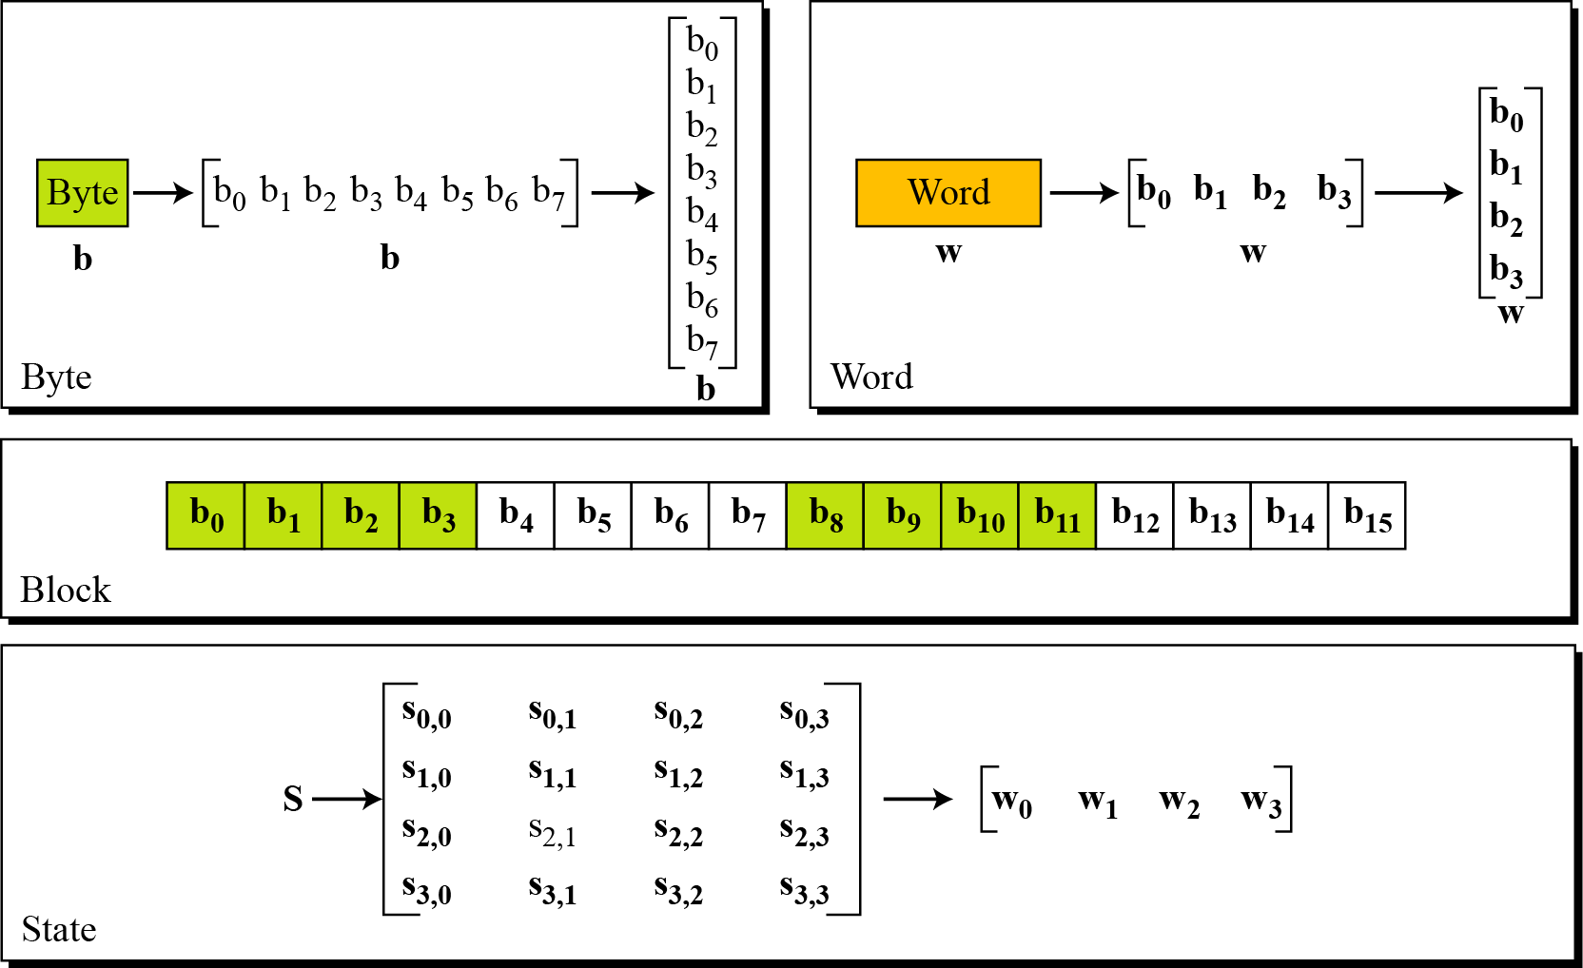
Data Unit

Slide 46
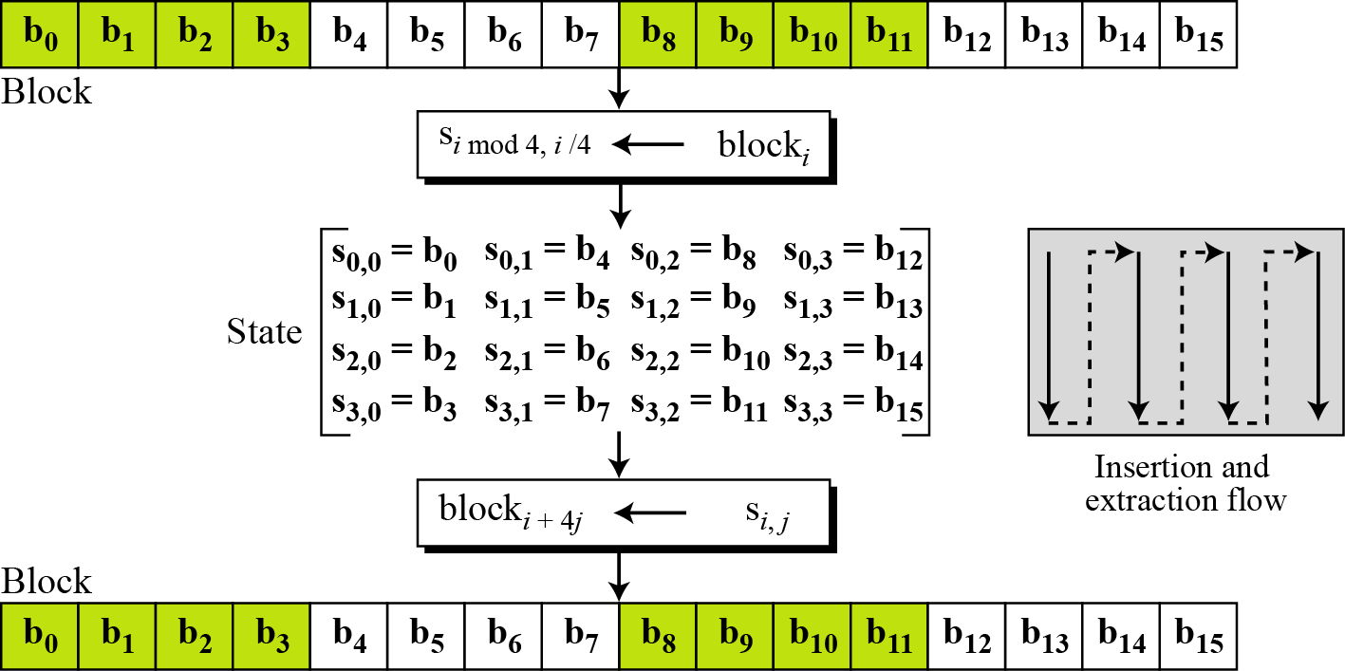
Unit Transformation

Slide 47
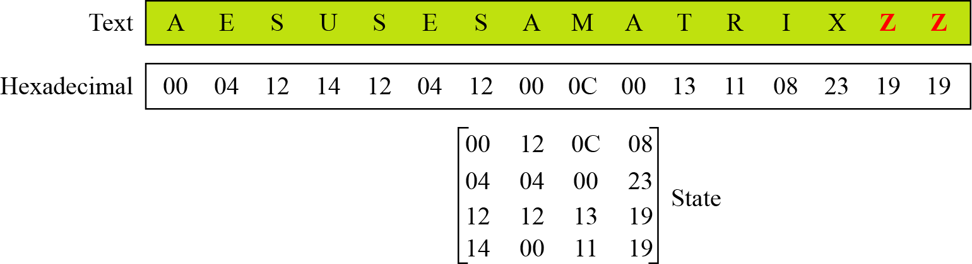
Changing Plaintext to State

Slide 48

SubBytes Operation
The SubBytes operation involves 16 independent byte-to-byte transformations.
Interpret the byte as two hexadecimal digits xy
SW implementation, use row (x) and column (y) as lookup pointer
S_{1,1} = xy₁₆
x’y’₁₆

Slide 49
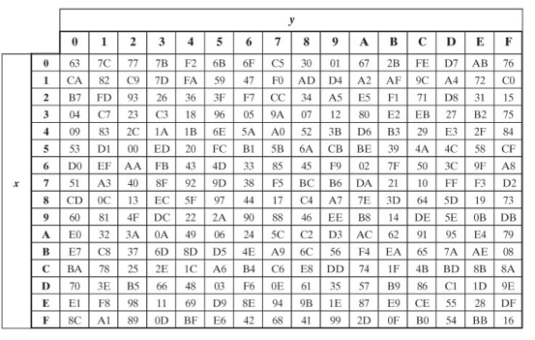
SubBytes Table
Implement by Table Lookup

Slide 50
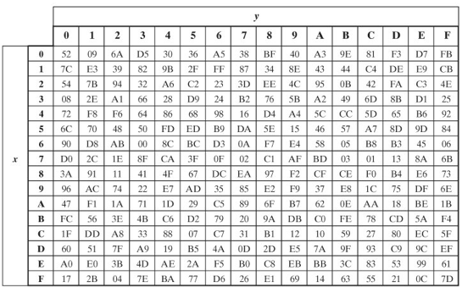
InvSubBytes Table

Slide 51
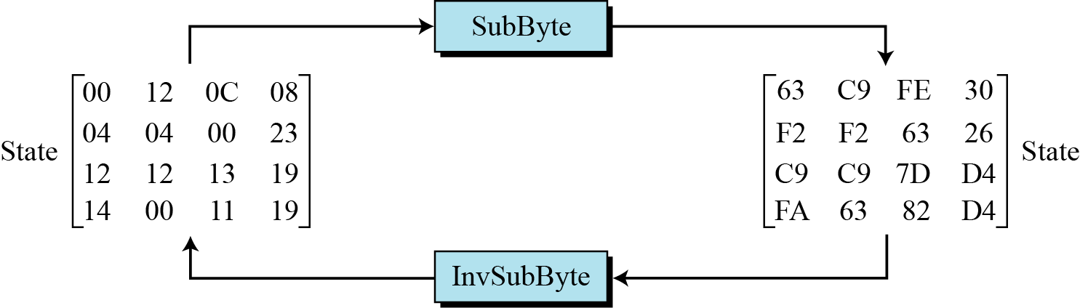
Sample SubByte Transformation
The SubBytes and InvSubBytes transformations are inverses of each other.

Slide 52
ShiftRows
Shifting, which permutes the bytes.
A circular byte shift in each each
  1st row is unchanged
  2nd row does 1 byte circular shift to left
  3rd row does 2 byte circular shift to left
  4th row does 3 byte circular shift to left
In the encryption, the transformation is called ShiftRows
In the decryption, the transformation is called InvShiftRows and the shifting is to the right
Notes:
The ShiftRows stage provides a simple “permutation” of the data, whereas the other steps involve substitutions. Further, since the state is treated as a block of columns, it is this step which provides for diffusion of values between columns. It performs a circular rotate on each row of 0, 1, 2 & 3 places for respective rows. When decrypting it performs the circular shifts in the opposite direction for each row. This row shift moves an individual byte from one column to another, which is a linear distance of a multiple of 4 bytes, and ensures that the 4 bytes of one column are spread out to four different columns.

Slide 53

ShiftRows Scheme
Notes:
Stalling Figure 5.5a illustrates the Shift Rows permutation.

Slide 54

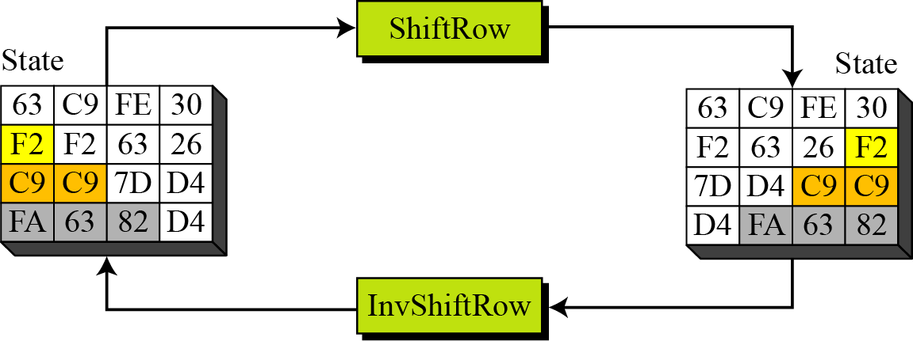
ShiftRows and InvShiftRows

Slide 55
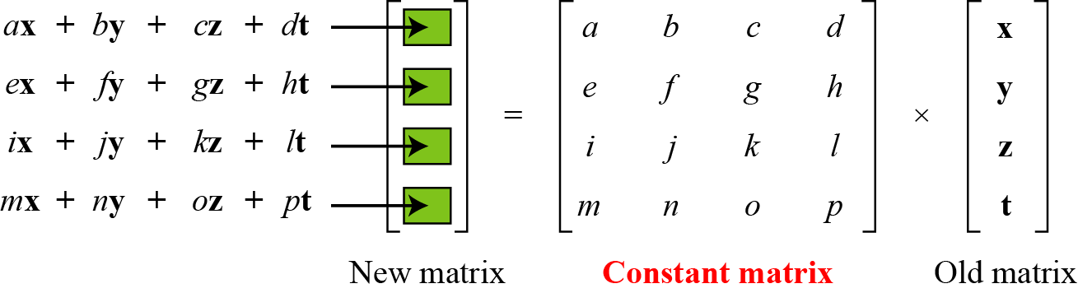
MixColumns
ShiftRows and MixColumns provide diffusion to the cipher
Each column is processed separately
Each byte is replaced by a value dependent on all 4 bytes in the column
Effectively a matrix multiplication in GF(2⁸) using prime poly m(x) =x⁸+x⁴+x³+x+1
Notes:
The MixColumns stage is a substitution that makes use of arithmetic over GF(2^8). Each byte of a column is mapped into a new value that is a function of all four bytes in that column. It is designed as a matrix multiplication where each byte is treated as a polynomial in GF(2⁸). The inverse used for decryption involves a different set of constants.
The constants used are based on a linear code with maximal distance between code words – this gives good mixing of the bytes within each column. Combined with the “shift rows” step provides good avalanche, so that within a few rounds, all output bits depend on all input bits.

Slide 56

MixClumns Scheme
The MixColumns transformation operates at the column level; it transforms each column of the state to a new column.
Notes:
Stalling Figure 5.5b illustrates the Mix Columns transformation.
In practise, you implement Mix Columns by expressing the transformation on each column as 4 equations (Stallings equation 5.4) to compute the new bytes for that column. This computation only involves shifts, XORs & conditional XORs (for the modulo reduction).
The decryption computation requires the use of the inverse of the matrix, which has larger coefficients, and is thus potentially a little harder & slower to implement.
The designers & the AES standard provide an alternate characterisation of Mix Columns, which treats each column of State to be a four-term polynomial with coefficients in GF(2⁸). Each column is multiplied by a fixed polynomial a(x) given in Stallings eqn 5.7. Whilst this is useful for analysis of the stage, the matrix description is all that’s required for implementation.

Slide 57
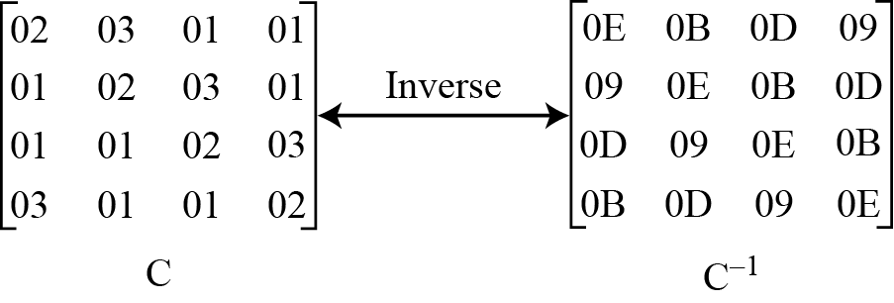
MixColumn and InvMixColumn

Slide 58
AddRoundKey
XOR state with 128-bits of the round key
AddRoundKey proceeds one column at a time.
  adds a round key word with each state column matrix
  the operation is matrix addition
Inverse for decryption identical
  since XOR own inverse, with reversed keys
Designed to be as simple as possible
Notes:
Lastly is the Add Round Key stage which is a simple bitwise XOR of the current block with a portion of the expanded key. Note this is the only step which makes use of the key and obscures the result, hence MUST be used at start and end of each round, since otherwise could undo effect of other steps. But the other steps provide confusion/diffusion/non-linearity. That us you can look at the cipher as a series of XOR with key then scramble/permute block repeated. This is efficient and highly secure it is believed.

Slide 59

AddRoundKey Scheme
Notes:
Stallings Figure 5.4b illustrates the Add Round Key stage, which like Byte Substitution, operates on each byte of state independently.

Slide 60

AES Round
Notes:
Can thus now view all the internal details of the AES round, showing how each byte of the state is manipulated, as shown in Stallings Figure 5.3.

Slide 61
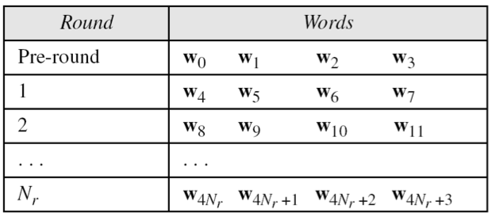
AES Key Scheduling
takes 128-bits (16-bytes) key and expands into array of 44 32-bit words
Notes:
The AES key expansion algorithm takes as input a 4-word (16-byte) key and produces a linear array of words, providing a 4-word round key for the initial AddRoundKey stage and each of the 10/12/14 rounds of the cipher. It involves copying the key into the first group of 4 words, and then constructing subsequent groups of 4 based on the values of the previous & 4th back words. The first word in each group of 4 gets “special treatment” with rotate + S-box + XOR constant on the previous word before XOR’ing the one from 4 back. In the 256-bit key/14 round version, there’s also an extra step on the middle word.

Slide 62
Implementation Aspects
The algorithms used in AES are so simple that they can be easily implemented using cheap processors and a minimum amount of memory.
Very efficient
Implementation was a key factor in its selection as the AES cipher
AES animation:
  http://www.cs.bc.edu/~straubin/cs381-05/blockciphers/rijndael_ingles2004.swf
Notes:
AES can also be very efficiently implemented on an 32-bit processor, by rewriting the stage transformation to use 4 table lookups & 4 XOR’s per column of state. These tables can be computed in advance using the formulae shown in the text, and need 4Kb to store.
The developers of Rijndael believe that this compact, efficient implementation was probably one of the most important factors in the selection of Rijndael for AES.

